Slide 1

AWS Devops

Slide 2
WHAT IS AWS?
AWS stands for Amazon Web Services. It is a cloud computing platform provided by Amazon that offers a wide range of services, including computing power, storage, databases, analytics, networking, mobile development, and more.

Slide 3
WHY AWS?
Amazon Web Services for cloud computing comes with several key advantages that make it a preferred choice for many businesses and organizations. Here are some reasons why AWS is often chosen:
Scalability and Flexibility
Comprehensive Service Offering
Security and Compliance
Cost Efficiency (Pay as you go pricing)

Slide 4
TYPES OF SERVICES IN AWS
S3 (Simple Storage Service)
EC2 (Elastic Compute Cloud)
IAM (Identity Access Management)​
EBS (Elastic Block Storage)
RDS (Relational Database Service)
Lambda etc...,

Slide 5
WHAT IS DEVOPS?
DevOps (software development approach) that emphasizes the coordination and communication between development (Dev) and operations (Ops) teams. The software development life-cycle is shortened, as well as the software quality and reliability of the software releases.
Some of the tools used in Devops:
Ansible
Jenkins
Maven etc..,

Slide 6
WHY DEVOPS?
DevOps is faster time to market, improved collaboration between teams, enhanced software quality, increased deployment frequency.Here some are key reasons why organizations adopt DevOps:
Faster Delivery of Software
Improved Collaboration and Communication
Higher Quality and Stability
Increased Efficiency and Productivity

Slide 7
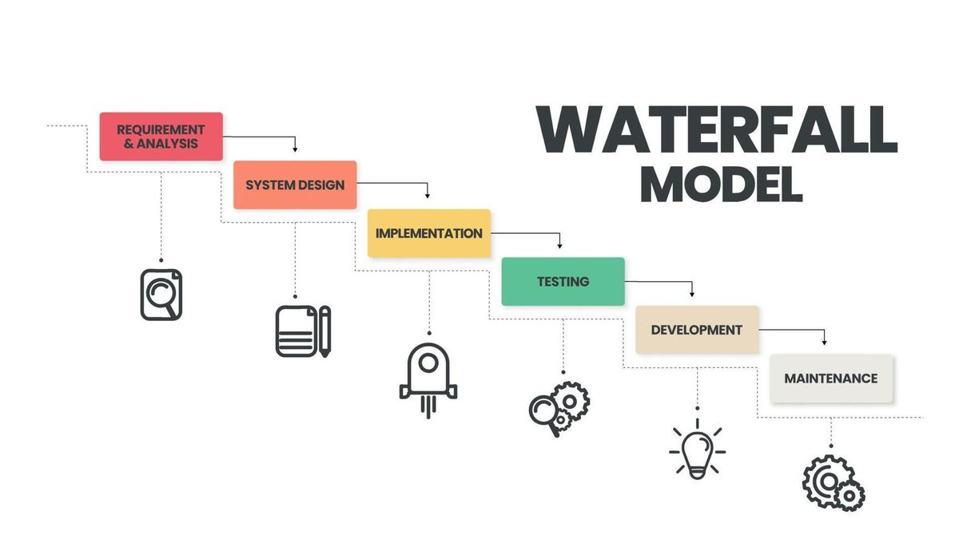
WATERFALL MODEL
The Waterfall model is a classical and a sequential method of software development. The process is divided into several phases in which each phase should be completed before the next one starts.

Slide 8
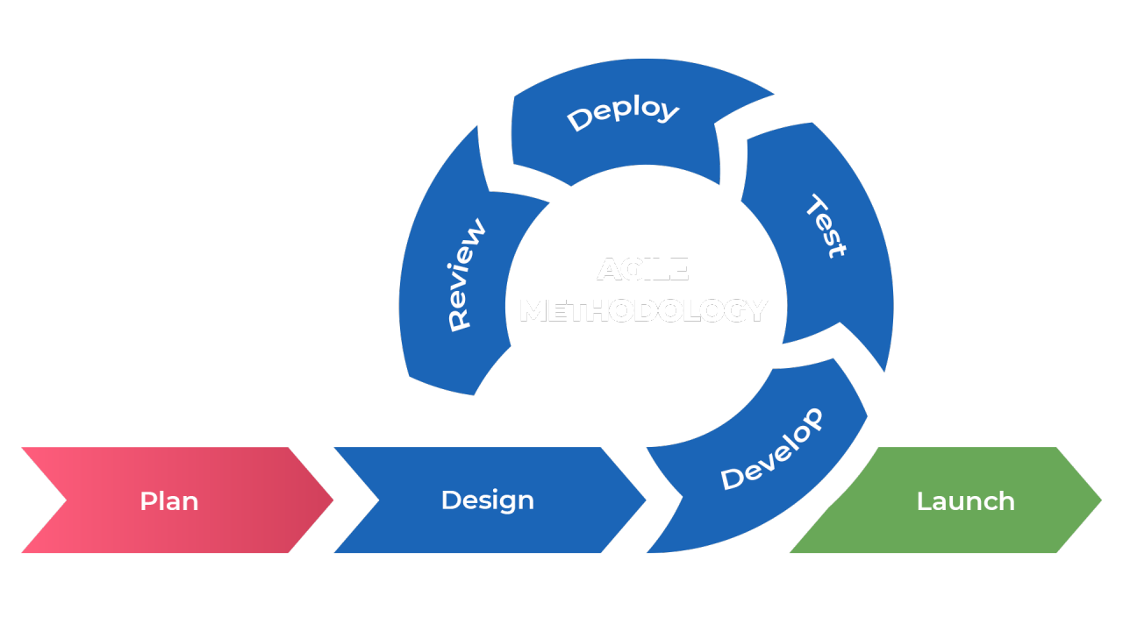
AGILE MODEL
The agile model is a software development approach that involves breaking projects into smaller sections kown as iterations or sprints, and releasing small changes into production frequently.
The agile model emphasizes collaboration and delivering a working product quickly.

Slide 9
PHASES OF AGILE MODEL
Planning:Define the project vision, objectives
Design:Create a basic design or architecture for the sprint or iterations.
Development:The development team starts coding based on the features selected for the sprint.
Testing:Continuous testing of the developed features.
Deployment:After testing, the working product increment is deployed
Review:At the end of each sprint, a review meeting or demo is held where the team showcases the completed features.

Slide 10
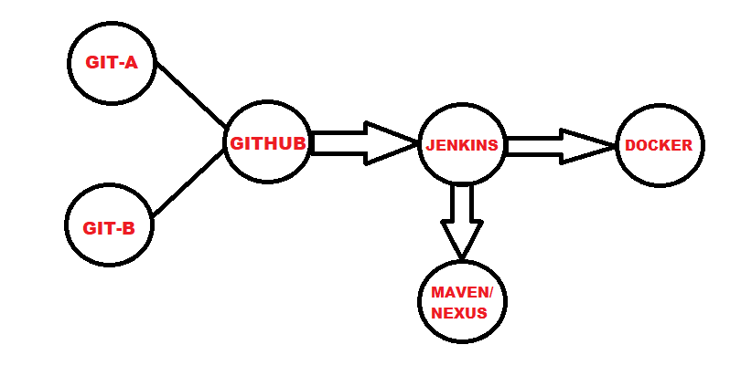
SOFTWARE DEVELOPMENT LIFE-CYCLE

Slide 11
TERRAFORM
Terraform is an open-source infrastructure-as-code (IaC) tool developed by HashiCorp. It allows you to define, provision, and manage cloud infrastructure resources (like servers, databases, and networks) using a declarative configuration language.
Terraform will work with all cloud providers(AWS,AZURE,ertc..,)

Slide 12
Key Features of Terraform:
Declarative language
provising across multiple providers
version control
state managmnet
execution plans
modules

Slide 13
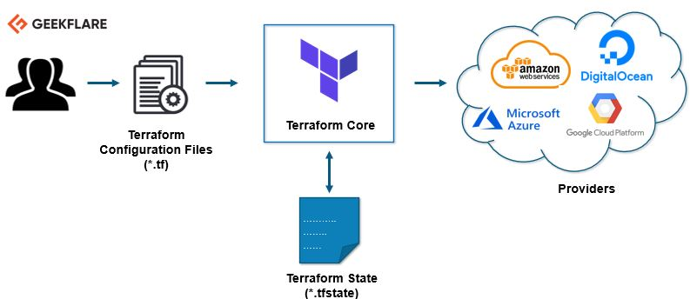
TERRAFORM ARCHITECTURE
Terraform’s architecture can be simplified into a few key components:
Configuration Files
Providers
State file

Slide 14
RESOURCE BLOCK IN TERRAFORM
Resource block in Terraform is a fundamental component that defines a specific piece of infrastructure.
Example:
resource "aws_instance" "my_ec2" {
ami = "ami-123456"
instance_type = "t2.micro"
tags = {
Name = "MyInstance"
}
}

Slide 15
VARIABLE BLOCK IN TERRAFORM
Variable block is used to define inputs for configurations.
Example:
variable "region" {
description = "The AWS region to create resources in"
type = string
default = "us-west-2"
}

Slide 16
OUTPUT BLOCK IN TERRAFORM
Output block is used to display useful information after your infrastructure has been deployed or updated.
Example:
resource "aws_instance" "example" {
ami = "ami-123456"
instance_type = "t2.micro"
}
output "instance_public_ip" {
value = aws_instance.example.public_ip
description = "The public IP address of the EC2 instance"
}

Slide 17
TERRAFORM COMMANDS
Terraform init: To initialize the working directory, downloading necessary providers and modules.
Terraform apply: To preview the changes Terraform will make to match the desired state.
Terraform plan: To execution the plan that showing what actions Terraform will take when applying changes (e.g., creating, modifying, or destroying resources).

Slide 18
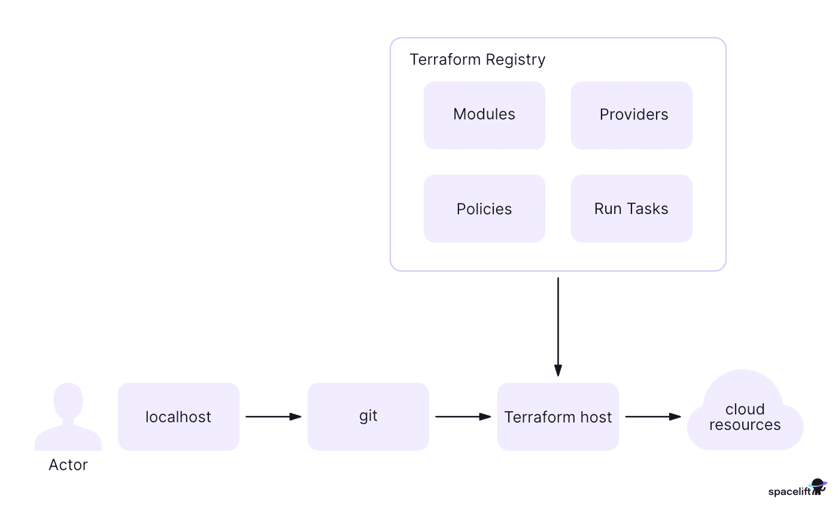
TERRAFORM REGISTRY
The Terraform Registry is an online repository where users sharing Terraform modules,providers,Policies and Run tasks.
Terraform registry is the combination of all cloud platforms providers.

Slide 19
TERRAFORM EXAMPLES
Example 1:
resource "aws_instance" "example" {
ami = var.ami_id
instance_type = var.instance_type
tags = {
Name = var.instance_name
}
}
Example 2:
resource "aws_instance" "example" {
ami = "ami-0c55b159cbfafe1f0"
instance_type = "t2.micro"
lifecycle {
create_before_destroy = true
}
}

Slide 20
IAM (Identity Access Management)
IAM stands for Identity Access Management.
It is an AWS Service that is used to manage the user accounts.
There are two key concepts in IAM
Authentication: The process of verifying the identity of a user or system.
Authorization:Authorization determines what user can do like (Permissions,access etc..,)

Slide 21
FEATURES OF IAM
Centralised control of your AWS account
Shared Access to your AWS account
Granular permissions
Identity Federation
Multifactor Authentication
Permissions based on Organizational groups
Networking controls
Supports PCI DSS Compliance
Eventually Consistent
Free to use

Slide 22
IAM IDENTITIES
IAM Users: Individual accounts created for people or applications.
IAM Groups: Collections of IAM users. Permissions are assigned to the group, and all members of the group inherit those permissions, simplifying management.
IAM Roles: Identity-based permissions that can be assumed by IAM users, applications, or AWS services.

Slide 23
ADVANTAGES OF IAM
Enhanced Security
Improved Productivity
Centralized Management
Reduced costs
Multi-factor authentication

Slide 24
WHAT IS S3?
S3 stands for Simple Storage Service. It is a storage service that provides an interface that you can use to store any amount of data, at any time, from anywhere in the world.

Slide 25
TYPES OF STORAGES IN S3
Standard
Reduced redundant storage
Intelligent
Standard -1A
One zone -1A
Clacier
Glacier Deep Archival

Slide 26
ADVANTAGES OF S3
Scalability
Durability and Availability
Cost-Effectiveness
Security
Easy Data Management

Slide 27
GIT
Git is a distributed version control system that tracks changes to files and coordinates work among multiple people on a project.
It allows users to manage and record changes to source code, collaborate on projects, and maintain a complete history of all modifications.

Slide 28
GIT COMMANDS
git init: Initializes a new Git repository in a directory
git add: Adds files or changes to the staging area, preparing them to be committed
git status: Shows the state of the working directory
git commit: Records staged changes with a descriptive message
git push: To push the data form local repository to remote repository
git pull: It is used to fetch and merge changes from a remote repository into your current working branch.

Slide 29
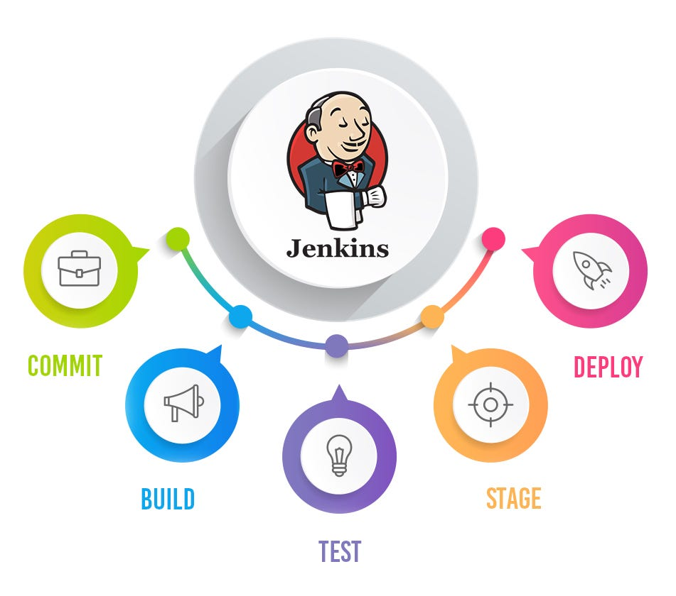
JENKINS
Jenkins is an open source automation tool written in java-programming language that allows continous integration
Jenkins will build and test the code
It supports continuous integration (CI) and continuous delivery (CD) pipelines, allowing teams to quickly integrate changes into a project and automate the deployment process.

Slide 30
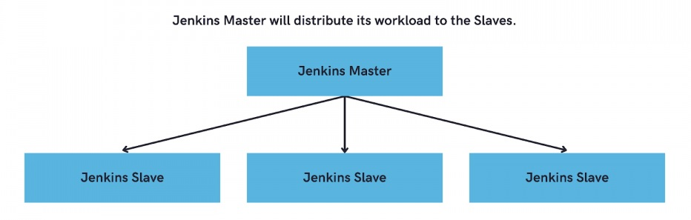
JENKINS ARCHITECTURE
The master schedules the jobs, allocates them to slaves, and the slaves perform the build, test, or deploy tasks. The results are sent back to the master for logging and further processing.

Slide 31
MAVEN
Maven is a popular open-source build tool developed by the Apache Group to build, publish,and deploy several projects at once for better project management.
Maven uses a central configuration file called pom.xml

Slide 32
PIPELINES
A pipeline is a series of processes or steps that data or tasks go through to achieve a specific outcome. In computing, pipelines are often used in software development, data engineering, and machine learning.
The concept is to break down complex workflows into smaller, manageable stages that are connected in sequence, where the output of one step becomes the input for the next.

Slide 33
TYPES OF PIPELINES
In Jenkins, a popular automation server, there are two main types of pipelines:
Declarative Pipeline:
Provides a more straightforward and readable syntax, designed to simplify the pipeline setup.
It uses a predefined, structured format with specific blocks, such as pipeline, agent, stages, and steps.
Scripted Pipeline:
Offers more flexibility by using Groovy-based scripting, allowing for complex logic and custom workflows.
Greater control and flexibility over pipeline steps; useful for more complex CI/CD requirements.

Slide 34
SAMPLE CODE
Example:
pipeline{
agent any
stages{
stage('Building'){
steps{
echo 'build'
}
}
stage('Testing'){
steps{
echo 'Test'
}
}
stage('Deployment'){
steps{
echo 'Deploy'
}
}
}
}

Slide 35
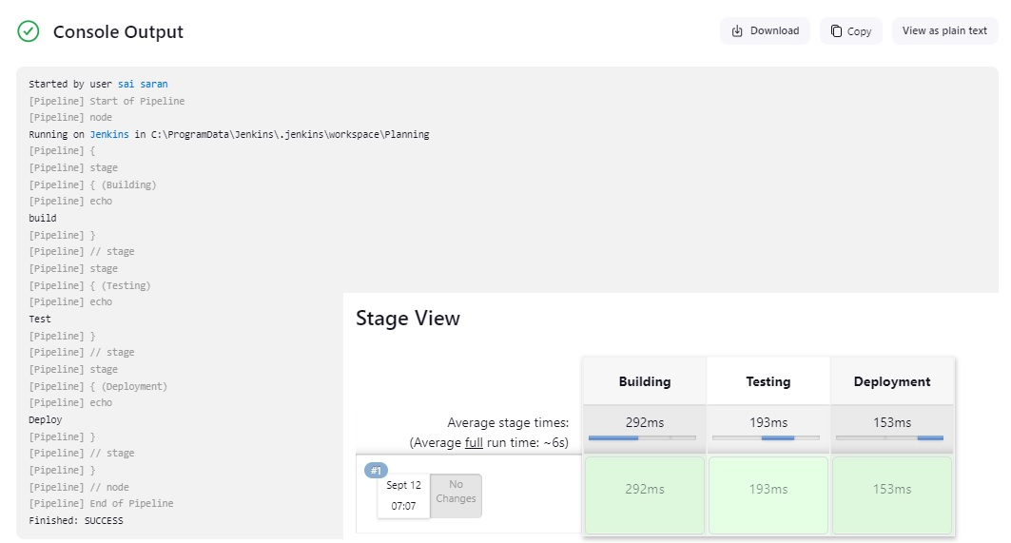
OUTPUT

Slide 36
SNS (SIMPLE NOTIFICATION SERVICE)
SNS stands for Simple Notification Service. It is a fully managed messaging service used to send notifications or messages to multiple subscribers, applications, or endpoints.
Sending alerts and notifications (e.g., for system monitoring or updates)
Key Feature of SNS:
Publish/Subscribe Model
Topics
Multiple Delivery Methods

Slide 37
SQS (SIMPLE QUEUE SERVICE)
SQS stands for Simple Queue Service is a distributed queue system that enables web service applications to quickly and reliably queue messages that one component in the application generates to be consumed by another component where a queue is a temporary repository for messages that are awaiting processing.
Using Amazon sqs, you can separate the components of an application so that they can run independently, easing message management between components.

Slide 38
QUEUE TYPES
Standard Queues:
These provide maximum throughput, best-effort ordering, and at-least-once delivery. However, messages might occasionally be delivered out of order or duplicated.
FIFO Queues (First-In-First-Out):
These ensure that messages are processed exactly once, in the exact order they are sent. FIFO queues are designed for applications that require strict message ordering and exactly-once message processing.

Slide 39
GDPR
GDPR Stand for General Data Protection Regulation
It is a legal framework established by the European Union (EU) that sets guidelines for the collection, processing, and protection of personal data of individuals within the EU and the European Economic Area (EEA).
GDPR is designed to give individuals more control over their personal data and to streamline data protection regulations across Europe.

Slide 40
How GDPR Applies:
Consent: Organizations must obtain explicit consent from individuals to process their data in certain situations.
Data Breach Notifications: Organizations must notify the relevant supervisory authority within 72 hours if they become aware of a personal data breach.
Data Protection Officer (DPO): Large organizations or those that process sensitive data may need to appoint a Data Protection Officer to oversee GDPR compliance.

Slide 41
GDPR DATA PROTECTION PRINCIPLES
Purpose Limitation
Lawfulness
Data Minimization
Confidentiality
Accuracy
Accountability
Storage limitation

Slide 42
SONARQUBE
SonarQube is an open-source platform used for continuous inspection of code quality. It performs automatic reviews of code to detect bugs, vulnerabilities, code smells, and issues related to maintainability and security.
SonarQube supports a wide range of programming languages and integrates with popular CI/CD pipelines.
It a vital tool in modern software development workflows.

Slide 43
KEY FEATURE OF SONAEQUBE
Code Quality Analysis
Supports Multiple Languages
Continuous Integration and DevOps Integration
Dashboard and Reporting
Customizable Quality Gates
Technical Debt Measurement
Plugins and Extensions

Slide 44
SOFTWARE TESTING CLASSIFICATION
Testing Types:
Manual Testing:
Testing performed manually by a tester without using any automated tools.
Automatic Testing:
Testing is done with the help of automated tools and scripts. To increase efficiency ,repatibility.
Testing Methods:
Static Method:Testing that is performed without executing the code. To identify defects early in the development process

Slide 45
Dynamic Method: Testing that is performed by executing the code To verify the functionality, performance, and behavior of the system
Testing Approaches:
Black Box: Testing based on knowledge of the internal structure of the software.
White Box: Testing without any knowledge of the internal code structure or logic.
Gray Box: Testing with partial knowledge of the internal structure of the system.

Slide 46
HOW SONARQUBE WOKS
Code Analysis:
SonarQube uses static code analysis to review source code without executing it. This means it scans the code to detect potential issues based on predefined rules and patterns.
SonarQube Scanner:
To analyze code, you need a SonarQube Scanner which is run locally or integrated within the CI pipeline. The scanner sends the code and results to the SonarQube server.
Server and Database:
SonarQube stores the results of code analysis in a central database, which allows for tracking and comparison of code quality over time.

Slide 47
WHAT IS DOCKER?
Docker is an open-source centralized platform that allows developers to automate the deployment, scaling, and management of applications using lightweight, portable containers.
These containers encapsulate an application along with its dependencies, ensuring consistency across different environments

Slide 48
WHY DOCKER?
Docker is popular because it offers portability, consistency, and scalability for deploying applications in different environments.
Docker containers are lightweight, isolated, and easy to deploy.
Here’s why Docker is widely adopted:
Consistency Across Environments
Portability
Efficiency and Speed
Isolation
Scalability

Slide 49
WHAT IS AWS DATABASE?
AWS Database refers to a suite of fully managed database services offered by Amazon Web Services (AWS) that cater to different types of data models and workloads.
These services are designed to help organizations store, manage, and query their data efficiently in the cloud.
AWS offers both relational and non-relational (NoSQL) database.
Relational Databases:
Amazon RDS (Relational Database Service)
Amazon Aurora

Slide 50
NoSQL Databases:
Amazon DynamoDB
Amazon DocumentDB
Key features of Database:
Data Storage & Retrieval
Data Integrity
Scalability
Data Security
Backup & Recovery
Performance Optimization

Slide 51
AMAZON RDS
Amazon RDS stands for Relational Database Service
It is a fully managed service provided by AWS that makes it easy to set up, operate, and scale relational databases in the cloud.
It supports popular database engines like MySQL, PostgreSQL, MariaDB, Oracle, and SQL Server, as well as AWS's high-performance engine

Slide 52
KEY FEATURES OF AMAZON RDS
Automated Management
High Availability
Scalability
Security
Performance

Slide 53
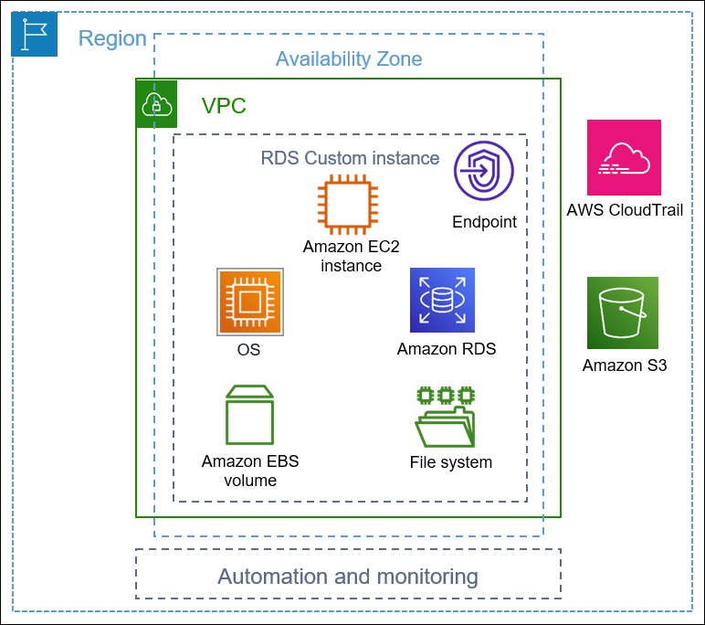
AMAZON RDS ARCHITECTURE

Slide 54


